Slide 1


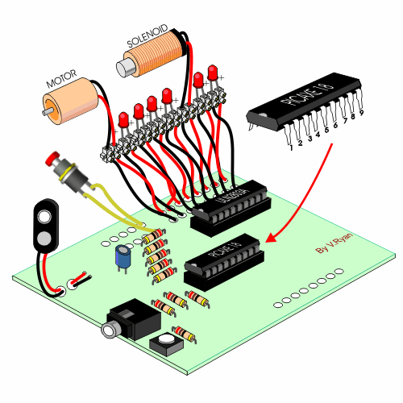

CHAPTER 0:
INTRODUCTION
STM32 EMBEDDED PROGRAMING
DO TRUNG HAU

Slide 2

CONTENTS
LAB 0: INTRODUCTION & SOFTWARE
LAB 1: GPIO – LED – LED 7 SEG (DIRECT)
LAB 2: GPIO – LED 7 SEG – LED 14 SEG (SCAN)
LAB 4: GPIO – BUTTON – KEYPAD - LCD
LAB 5: TIMER – RTC – SYSTICK
STM32 EMBEDDED SYSTEMS
ARM CORTEX M

Slide 3
CONTENTS
LAB 6: TIMER – COUNTER MOD
LAB 7: TIMER - PWM
LAB 8: ANALOG TO DIGITAL CONVERTER
LAB 9: DIRECT MEMORY ACCESS
LAB 10: COMMUNICATION OF UART
STM32 EMBEDDED SYSTEMS
ARM CORTEX M

Slide 4
CONTENTS
LAB 11: COMMUNICATION OF I2C
LAB 12: COMMUNICATION OF SPI
LAB 13: COMMUNICATION OF ONEWIRE
LAB 14: COMMUNICATION OF BLUETOOTH
LAB 15: COMMUNICATION OF WIFI
STM32 EMBEDDED SYSTEMS
ARM CORTEX M

Slide 5

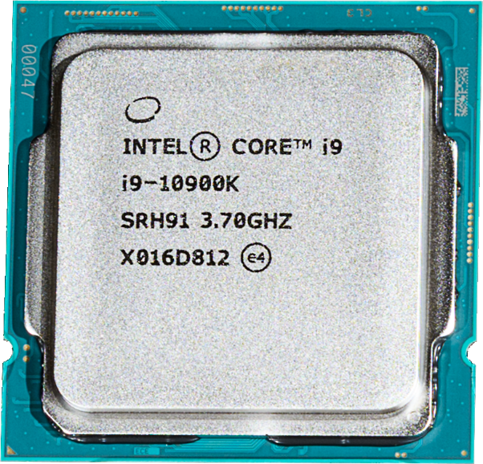
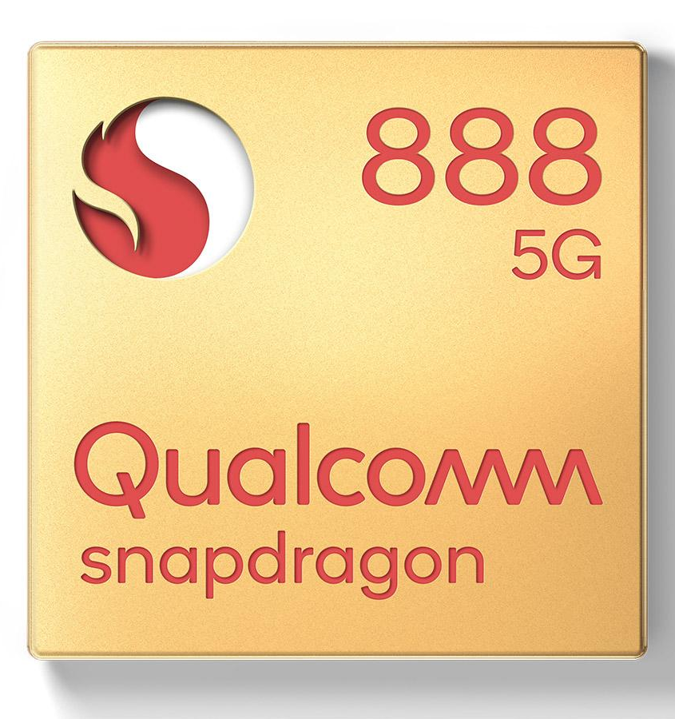
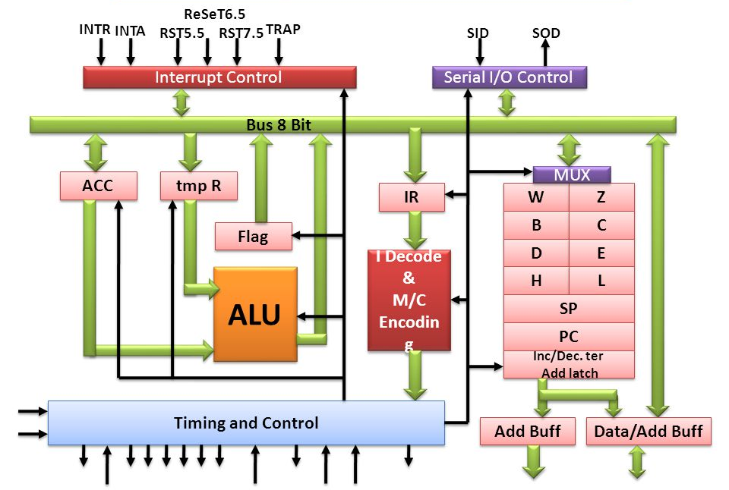
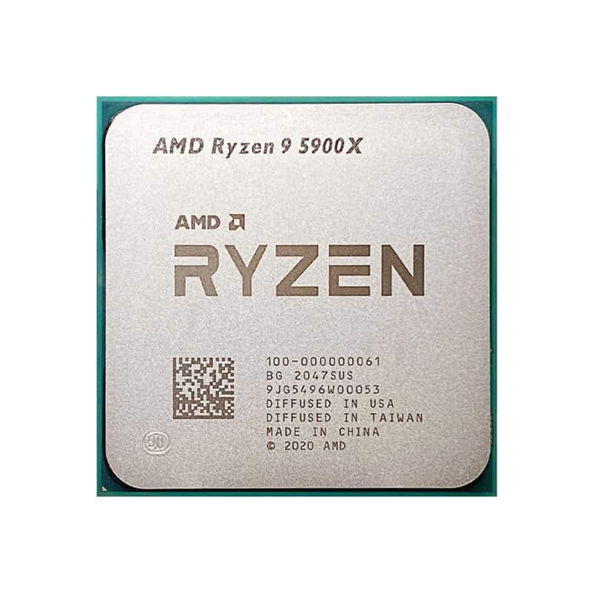

LAB 0: INTRODUCTION AND SOFTWARE
MICROPROCESSOR
STM32 EMBEDDED SYSTEMS
ARM CORTEX M

Slide 6
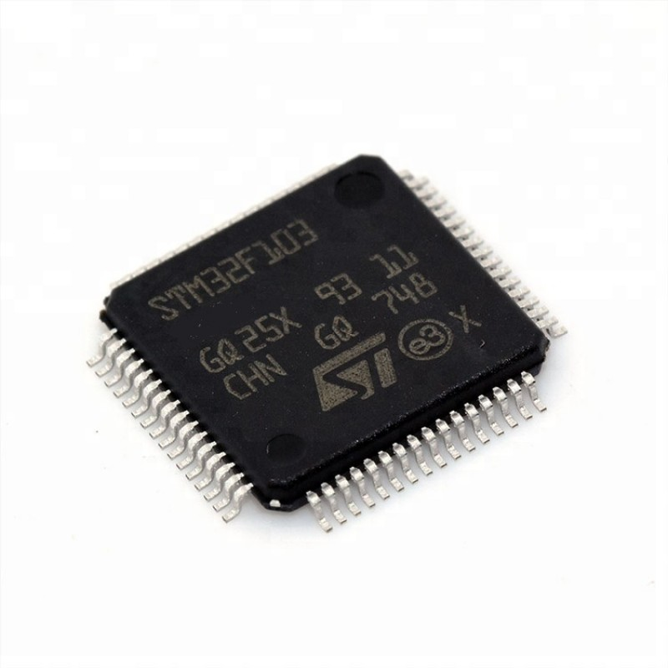
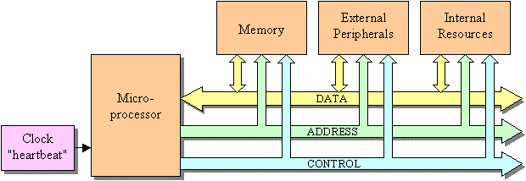
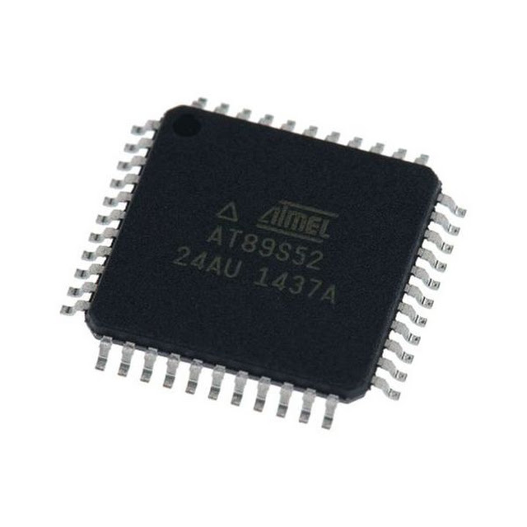
LAB 0: INTRODUCTION AND SOFTWARE
MICROCONTROLLER
STM32 EMBEDDED SYSTEMS
ARM CORTEX M

Slide 7
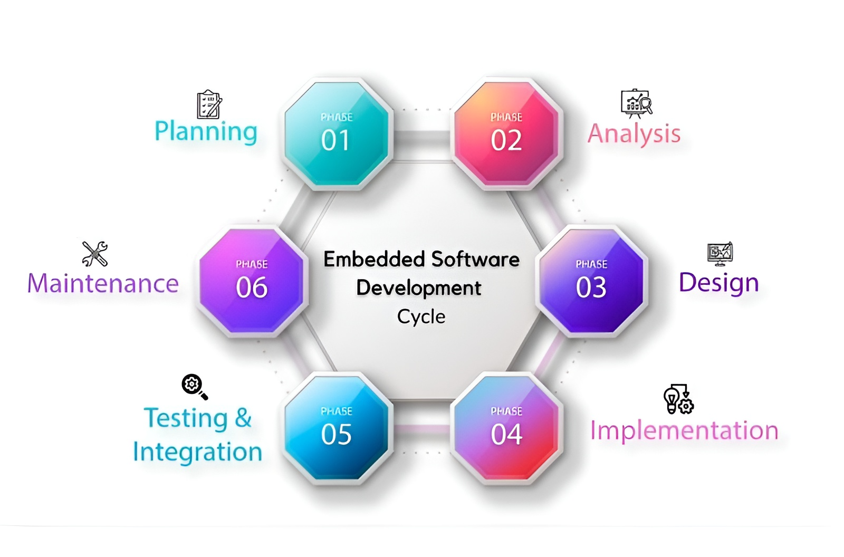
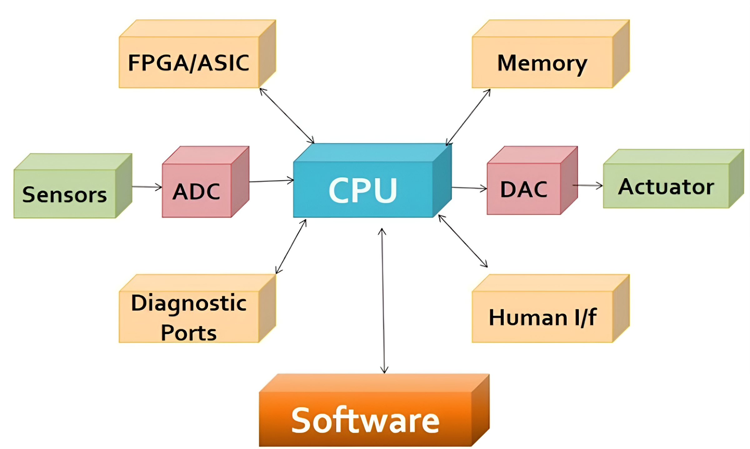
LAB 0: INTRODUCTION AND SOFTWARE
EMBEDDED SYSTEM
STM32 EMBEDDED SYSTEMS
ARM CORTEX M

Slide 8
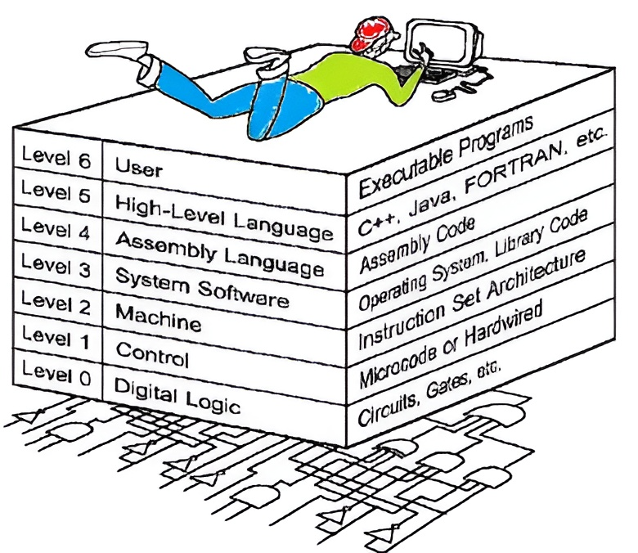
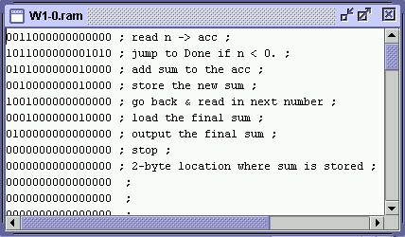
LAB 0: INTRODUCTION AND SOFTWARE
COMPUTER ARCHITECTURE
STM32 EMBEDDED SYSTEMS
ARM CORTEX M

Slide 9
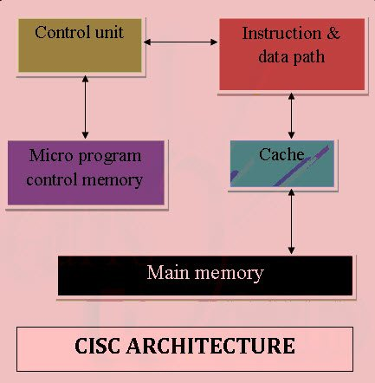
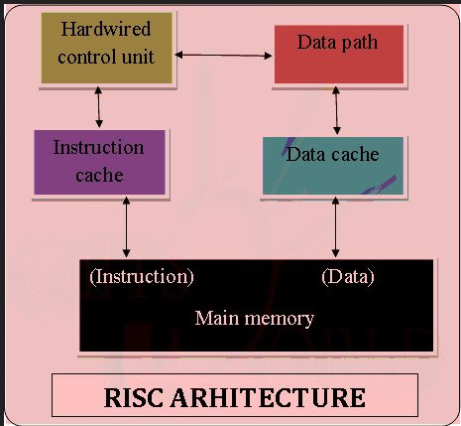
LAB 0: INTRODUCTION AND SOFTWARE
COMPUTER ARCHITECTURE
STM32 EMBEDDED SYSTEMS
ARM CORTEX M

Slide 10
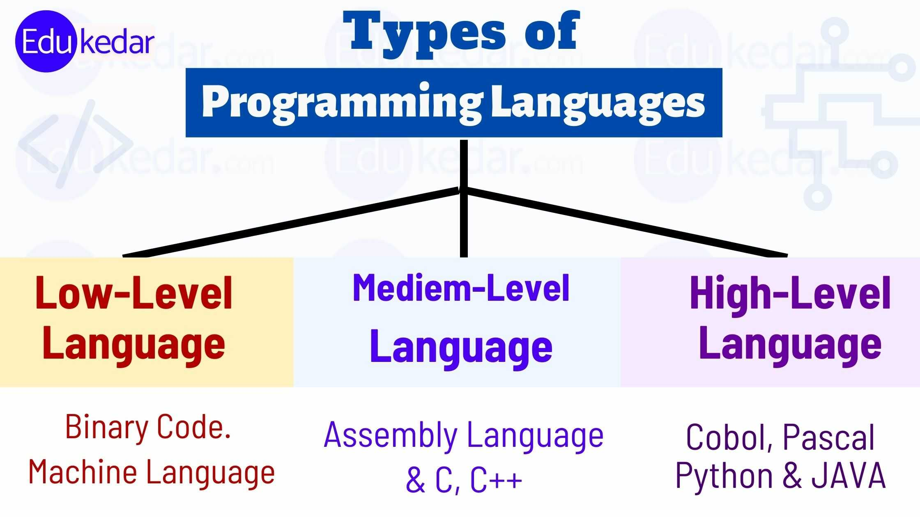
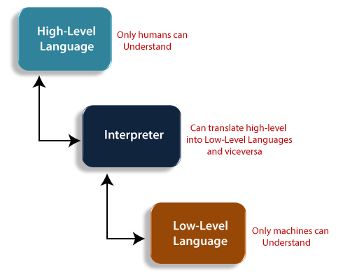
LAB 0: INTRODUCTION AND SOFTWARE
PROGRAMING LANGUAGE
STM32 EMBEDDED SYSTEMS
ARM CORTEX M

Slide 11
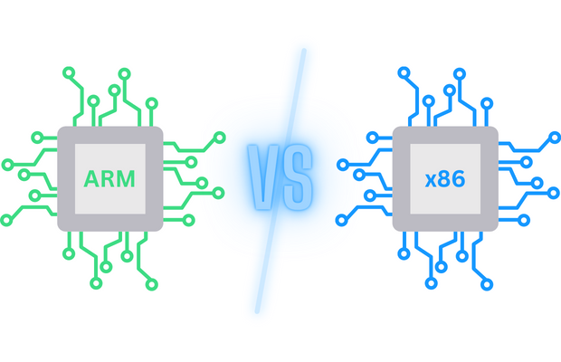
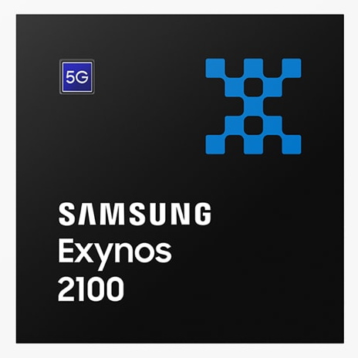
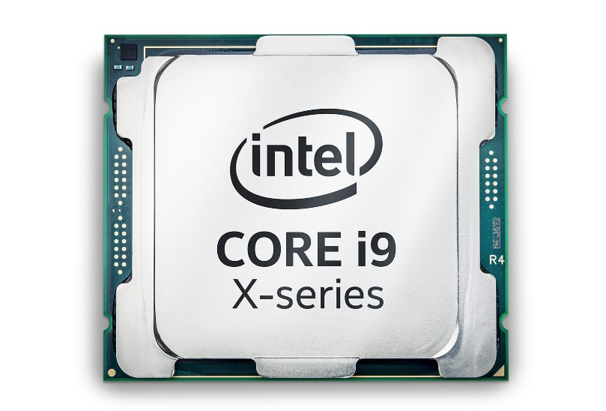
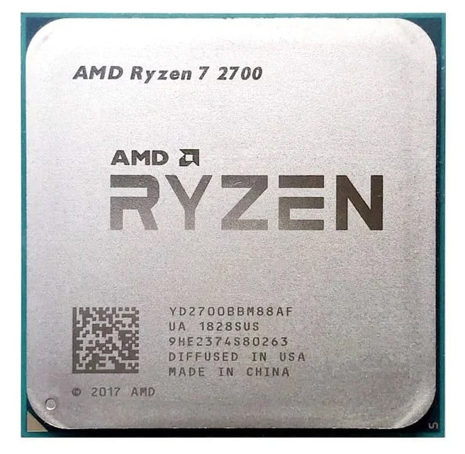
LAB 0: INTRODUCTION AND SOFTWARE
MCU SELECTION: ARM CORTEX M
The most commonly used architecture
Energy saving
High performance
Easy to develop embedded systems
More versions
STM32 EMBEDDED SYSTEMS
ARM CORTEX M

Slide 12
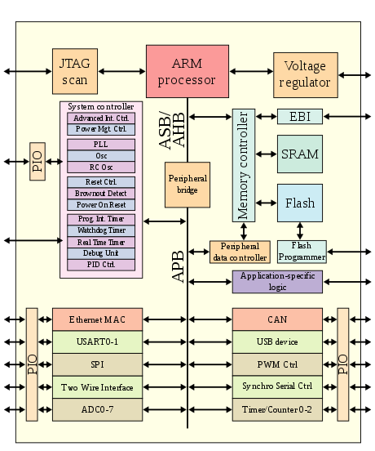
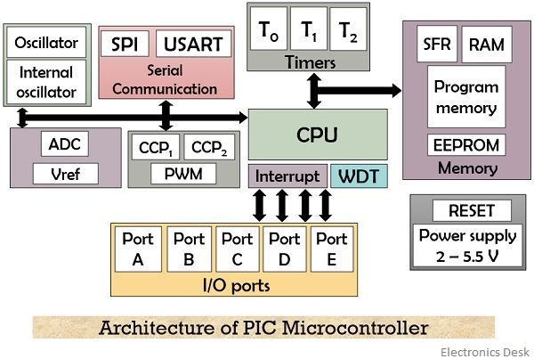
LAB 0: INTRODUCTION AND SOFTWARE
PIC - ARM ARCHITECTURE
STM32 EMBEDDED SYSTEMS
ARM CORTEX M

Slide 13
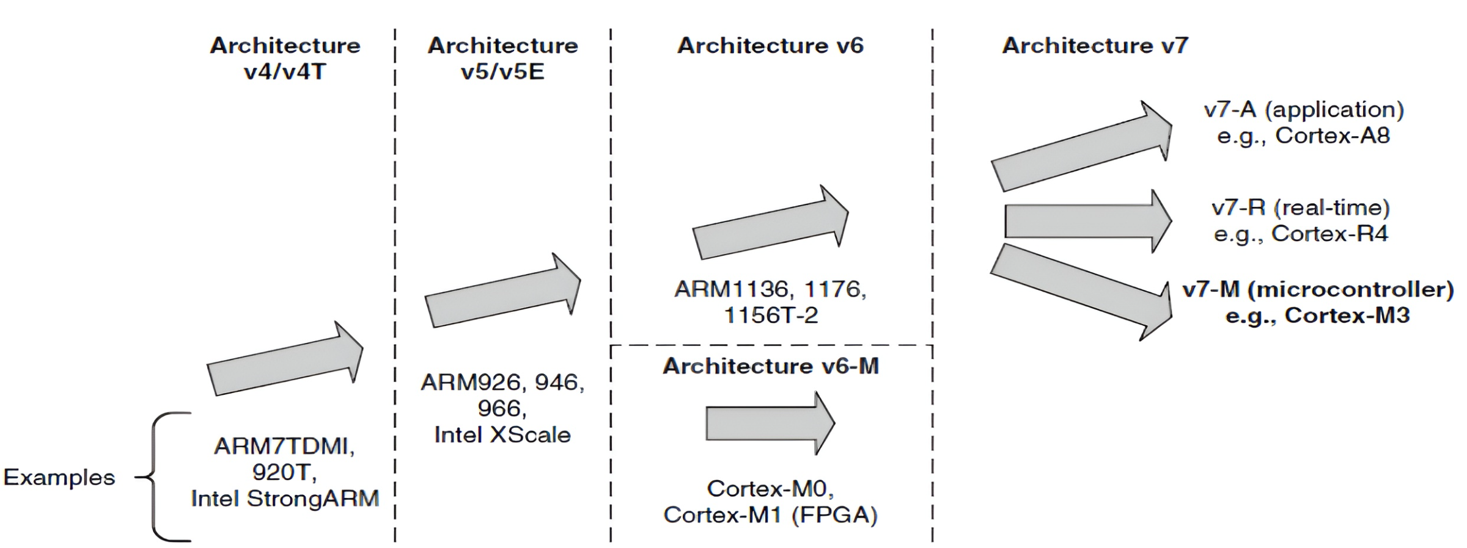
LAB 0: INTRODUCTION AND SOFTWARE
ARM CORTEX M
STM32 EMBEDDED SYSTEMS
ARM CORTEX M

Slide 14
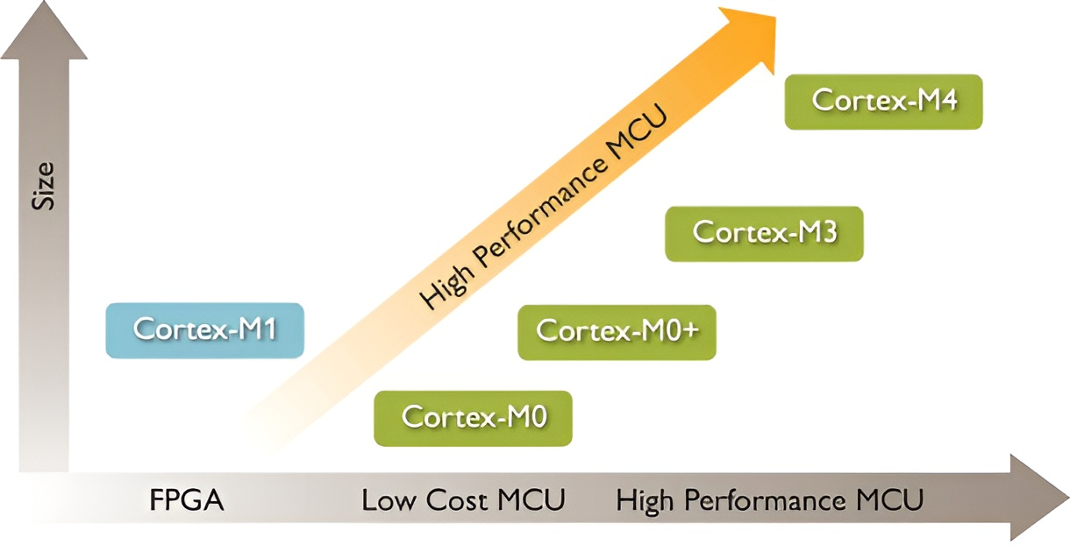
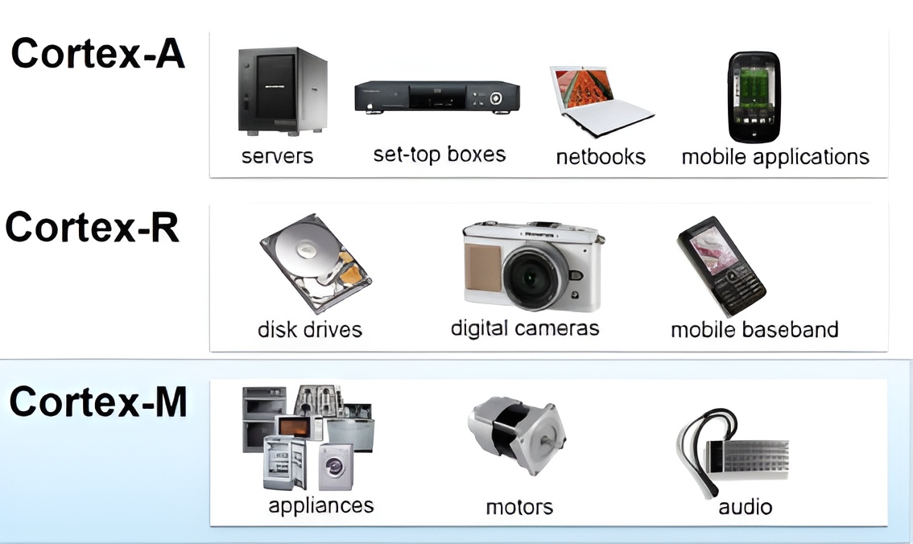
LAB 0: INTRODUCTION AND SOFTWARE
ARM CORTEX M3
STM32 EMBEDDED SYSTEMS
ARM CORTEX M

Slide 15
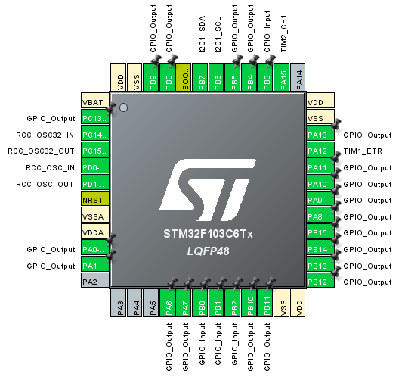
LAB 0: INTRODUCTION AND SOFTWARE
SOFTWARE
STM32 EMBEDDED SYSTEMS
ARM CORTEX M

Slide 16

LAB 0: INTRODUCTION AND SOFTWARE
SOFTWARE
lcd3x4_display(hour/16, 0); lcd3x4_display(hour%16, 3); lcd3x4_display(min/16, 7); lcd3x4_display(min%16, 10); lcd3x4_display(sec/16, 14); lcd2x3_display(sec%16, 0, 17); led7_seg[0]=numc[prod/10]; led7_seg[1]=numc[prod%10]; led7seg_display();
STM32 EMBEDDED SYSTEMS
ARM CORTEX M

Slide 17
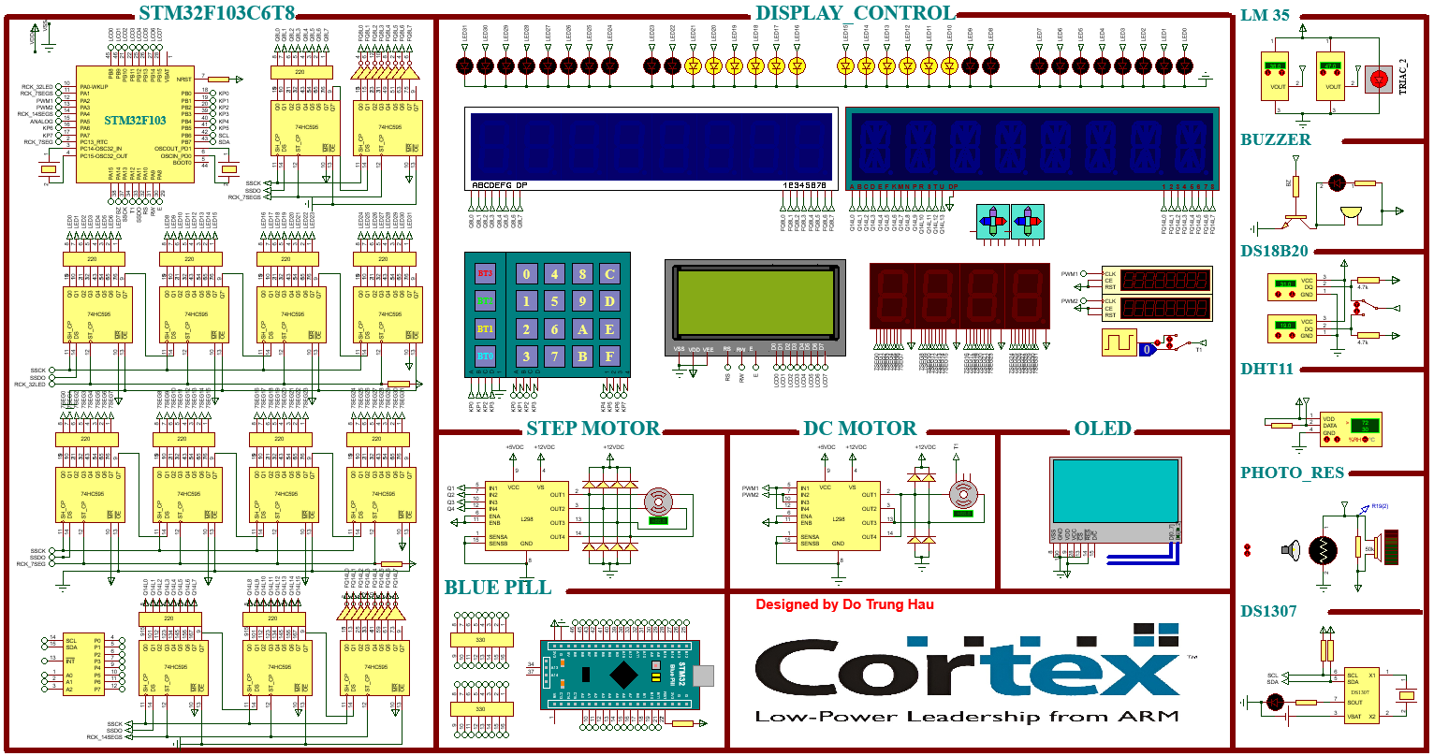
LAB 0: INTRODUCTION AND SOFTWARE
STM32 EMBEDDED SYSTEMS
ARM CORTEX M

Slide 18
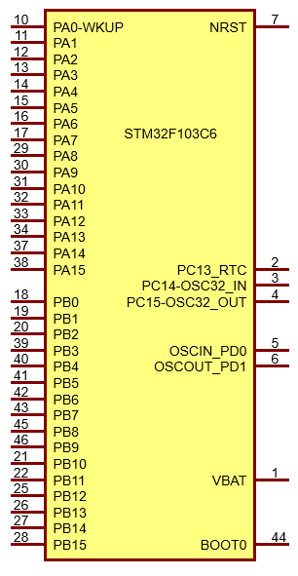
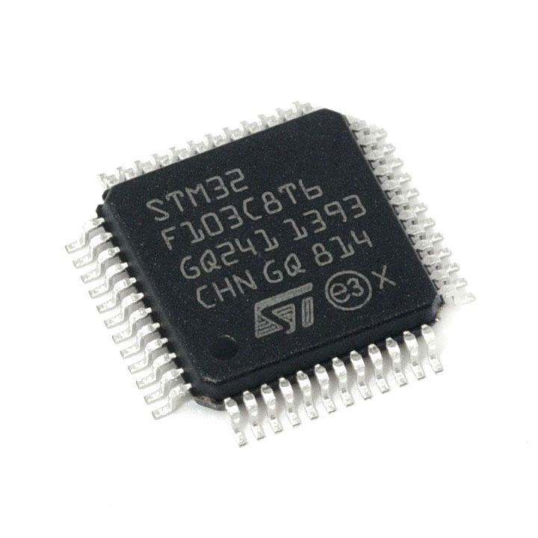
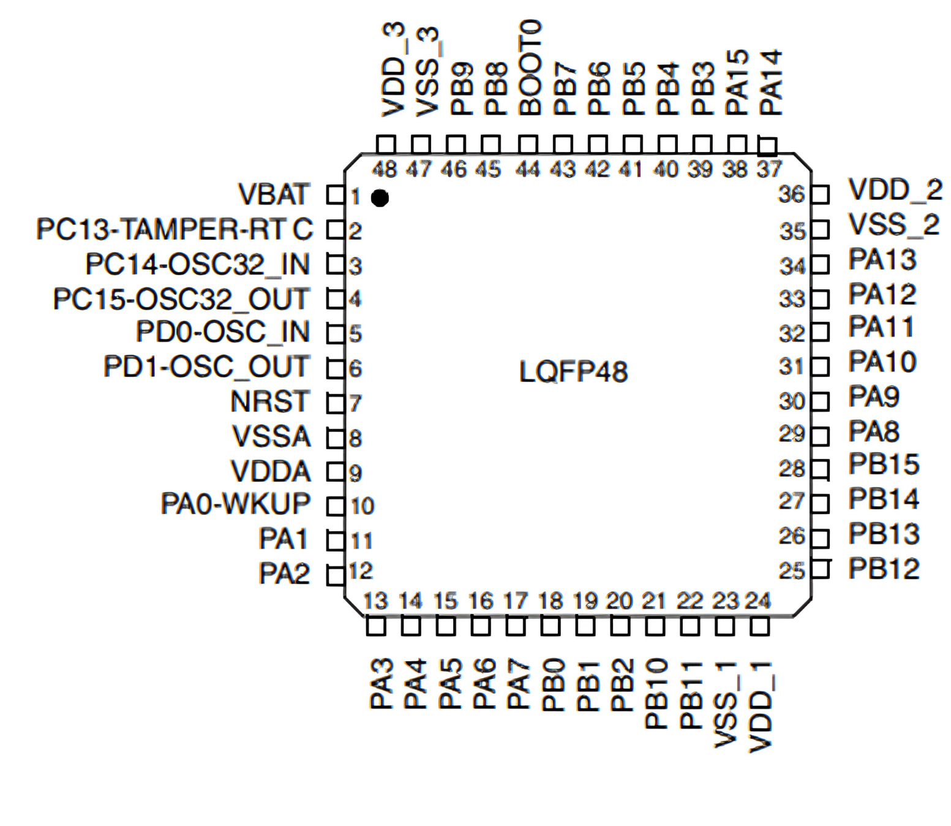
LAB 0: INTRODUCTION AND SOFTWARE
STM32F103C6
STM32 EMBEDDED SYSTEMS
ARM CORTEX M

Slide 19
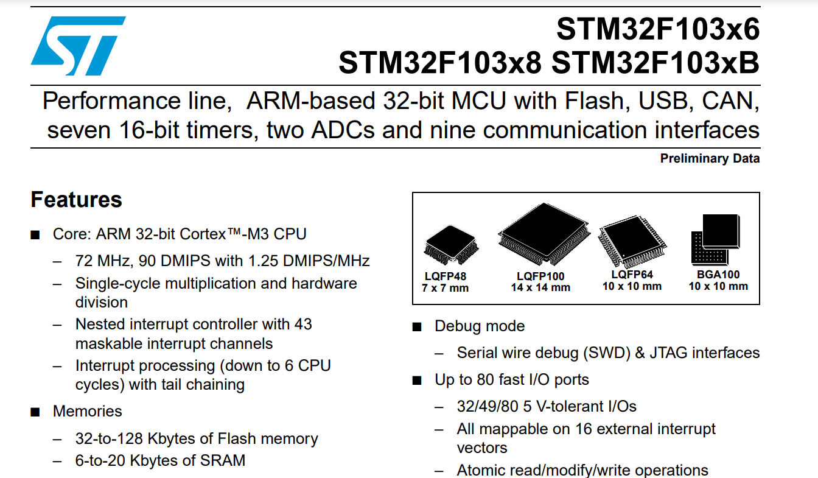

LAB 0: INTRODUCTION AND SOFTWARE
DATASHEET
STM32 EMBEDDED SYSTEMS
ARM CORTEX M

Slide 20
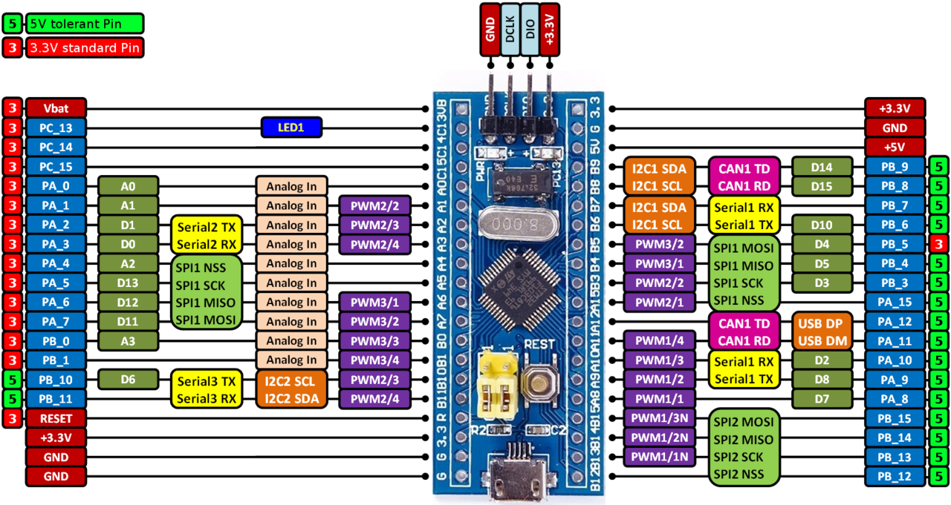
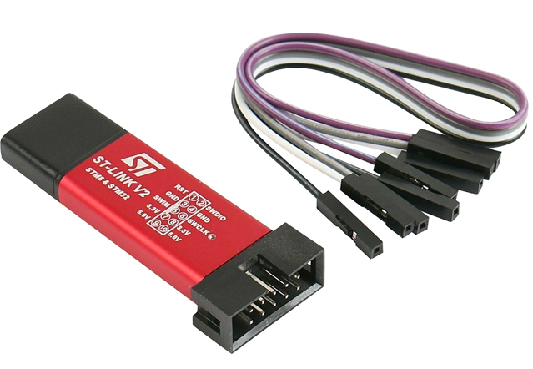
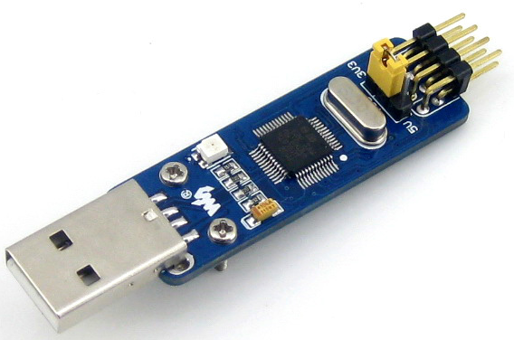
LAB 0: INTRODUCTION AND SOFTWARE
STM32F103C6
STM32 EMBEDDED SYSTEMS
ARM CORTEX M

Slide 21
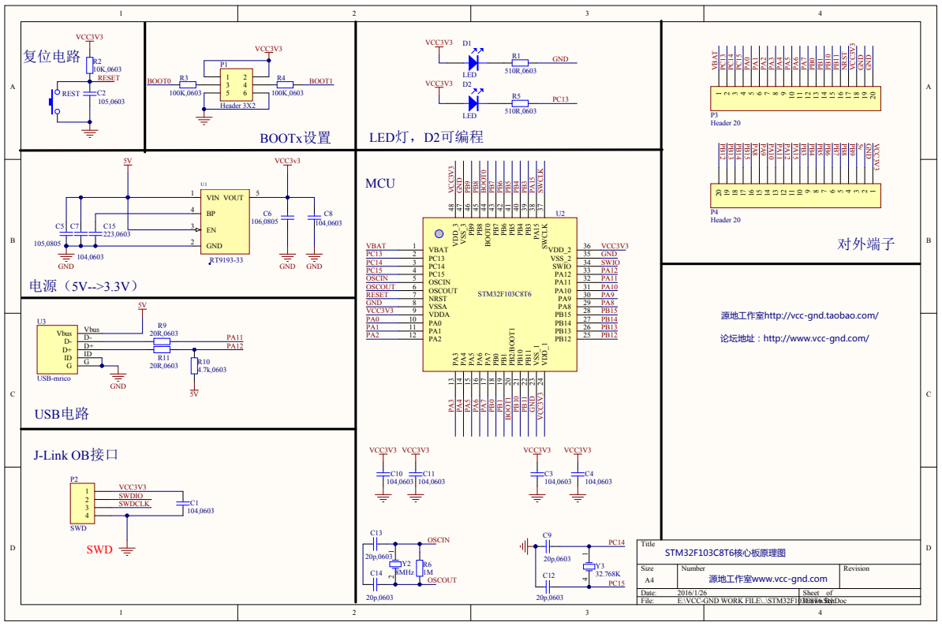
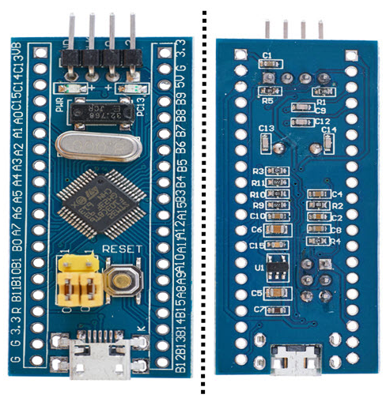
LAB 0: INTRODUCTION AND SOFTWARE
SCHEMATIC
STM32 EMBEDDED SYSTEMS
ARM CORTEX M

Slide 22
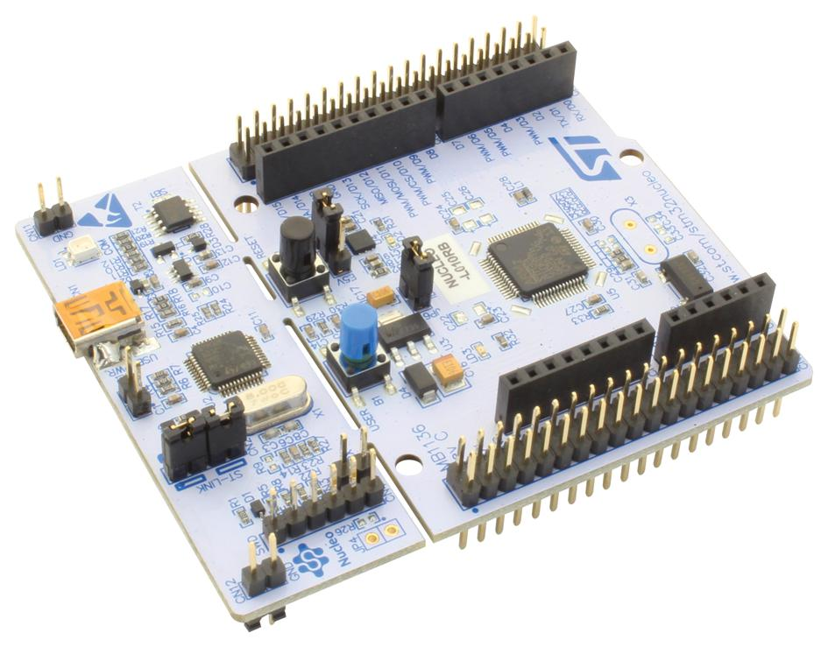
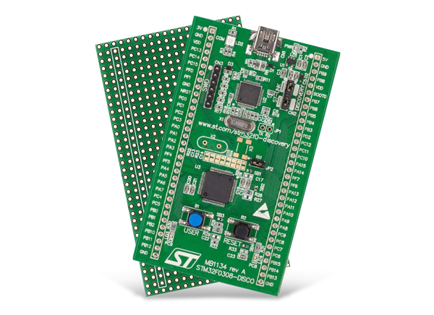
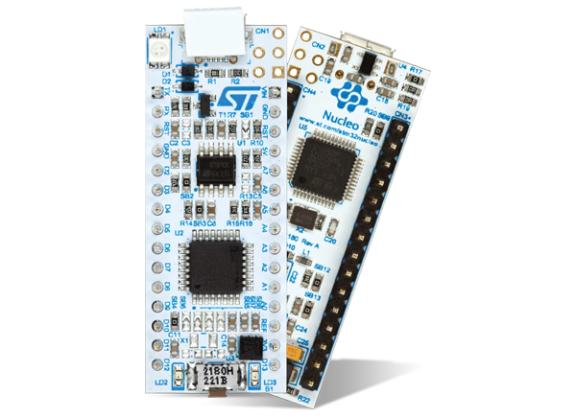
LAB 0: INTRODUCTION AND SOFTWARE
SCHEMATIC
STM32 EMBEDDED SYSTEMS
ARM CORTEX M
2

Slide 23
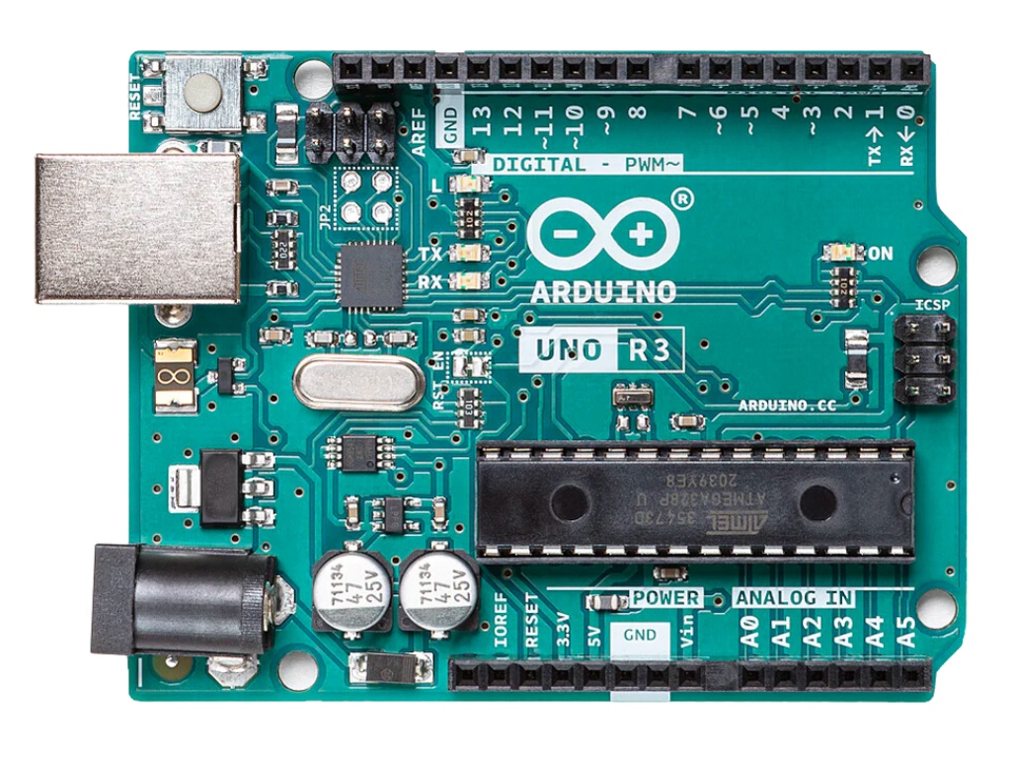
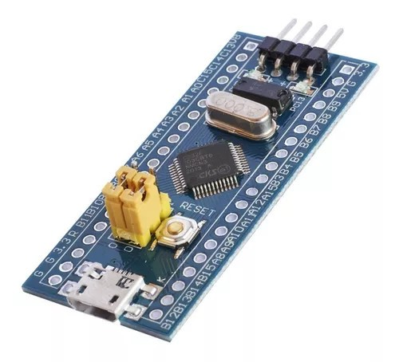
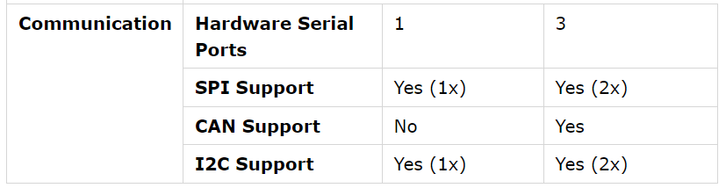
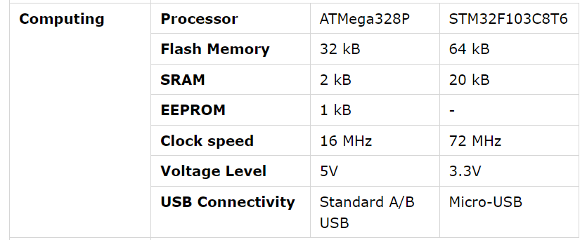
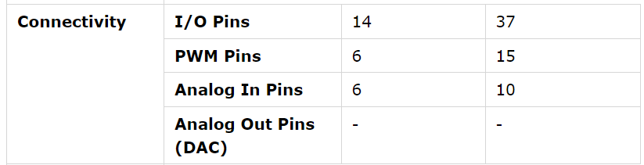
LAB 0: INTRODUCTION AND SOFTWARE
COMPARISION
145.000
60.000 + 45.000
STM32 EMBEDDED SYSTEMS
ARM CORTEX M

Slide 24
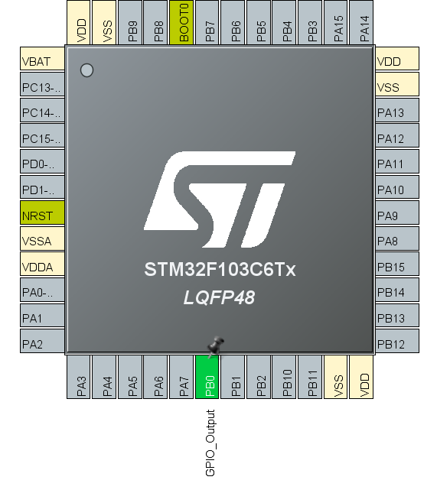
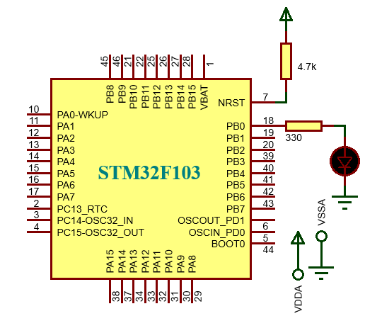
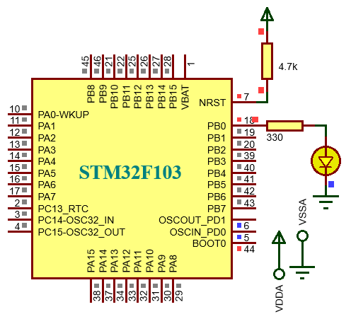
LAB 0: INTRODUCTION AND SOFTWARE
THE FIRST PROJECT
P1. Write a program to control a led connected to pin B0 of STM32F103C6. The status of two LEDs are switched every 1 seconds between “ON” and “OFF”.
HAL_GPIO_TogglePin(GPIOB, GPIO_PIN_0);
HAL_Delay(1000);
STM32 EMBEDDED SYSTEMS
ARM CORTEX M

